Slide 1

Lending Club Case Study
Vaibhav J
Lavanya M

Slide 2
Overview
This company is the largest online loan marketplace, facilitating personal loans, business loans, and financing of medical procedures. Borrowers can easily access lower interest rate loans through a fast online interface.

Slide 3
Problem Statement
Aim | Objective | Approach
To identify these risky loan applicants, then such loans can be reduced thereby cutting down the amount of credit loss. | To understand the driving factors behind loan default, i.e. the variables which are strong indicators of default. | Identification of such applicants using EDA is the aim of this case study.

Slide 4
Data for analysis
Dropped null columns as they will not help in analysis.
Dropped loan status Current as it will not be considered for analysis.
Outliers are handled where it can affect the analysis,
Some more data is derived from existing columns to understand data more clearly.

Slide 5
Univariate Analysis Results
Presenting observations and finding after preforming univariate analysis on cleaned data.

Slide 6
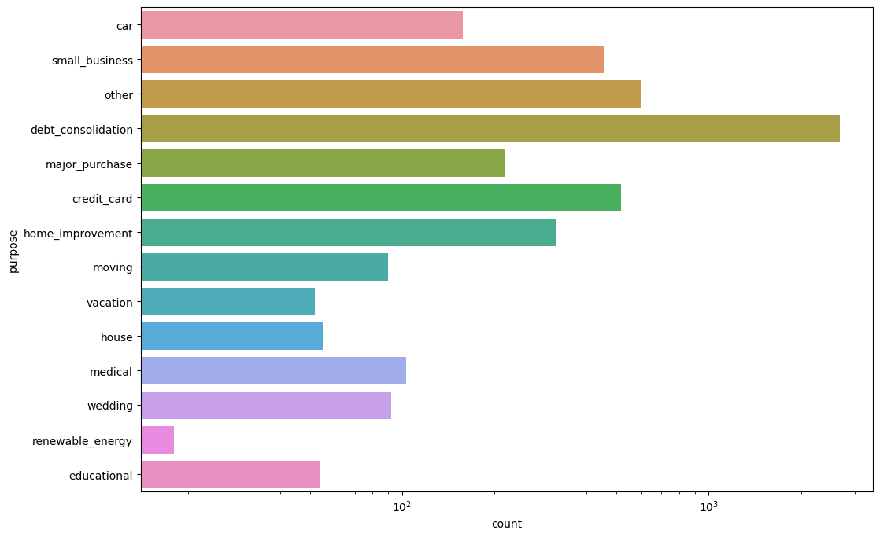
Analysis Result
Analysis :- By purpose
Findings/Observation:
People who’s purpose of the loan is debt consolidation have high probability of defaulting loan.

Slide 7
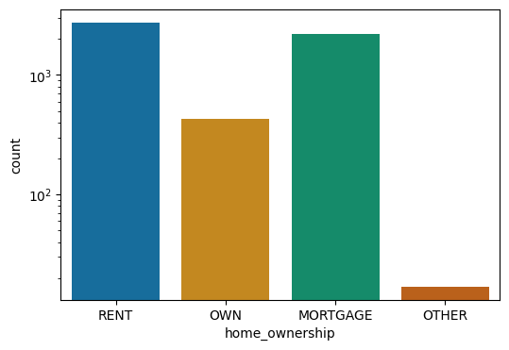
Analysis Result
Analysis :- By home ownership
Findings/Observation:
Applicants having house ownership as ‘RENT’ have high probability of defaulting loan.
'

Slide 8
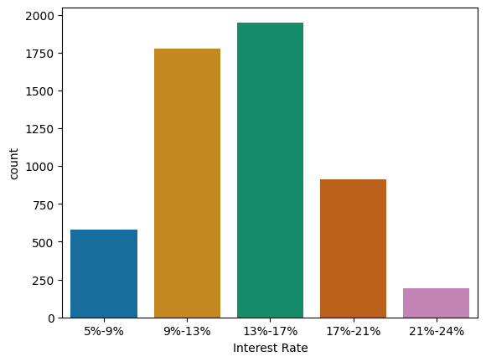
Analysis Result
Analysis :- By Interest Rate
Findings/Observation:
Applicants having interest rate of 13-17% is most likely to default loan.
'

Slide 9
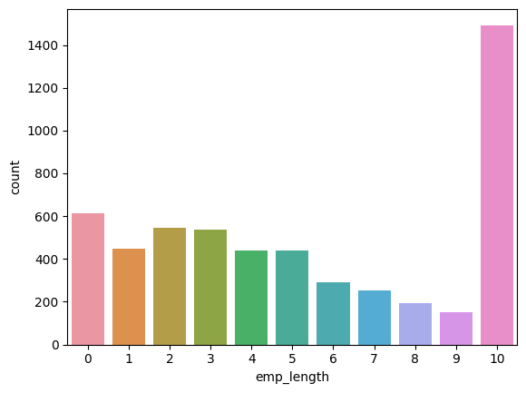
Analysis Result
Analysis :- By having employment length
Findings/Observation:
Applicants having employment length of 10 are most likely to default loan.

Slide 10
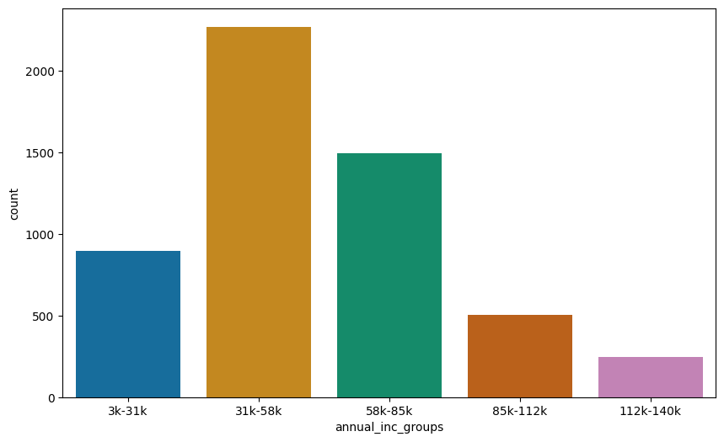
Analysis Result
Analysis :- By annual income
Findings/Observation:
Applicants having income in range of 31-59K are most likely to default loan.

Slide 11
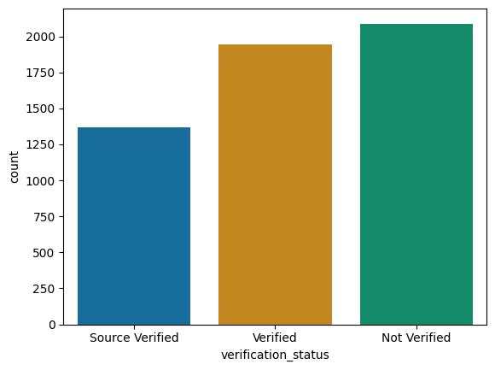
Analysis Result
Analysis :- By verification status
Findings/Observation:
Applicants who are not verified have high chance of defaulting loan.

Slide 12
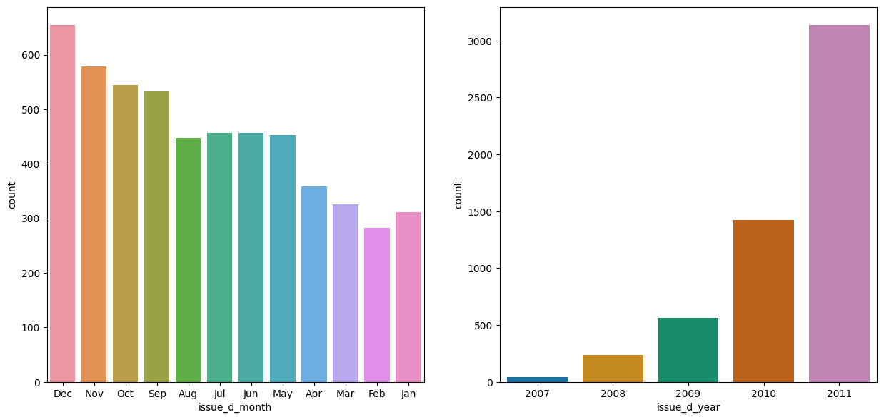
Analysis Result
Analysis :- By issue_d
Findings/Observation:
Maximum number of defaults occurred when loan issued at the end of the year.
Maximum number of defaults occurred when loan issued in year 2011

Slide 13
The above analysis with respect to the charged off loans for each variable suggests the following. There is a more probability of defaulting when :
Applicants having house_ownership as 'RENT'
Applicants who use the loan to clear other debts
Applicants who receive interest at the rate of 13-17%
Applicants who have an income of range 31201 - 58402
Applicants who have 20-37 open_acc
Applicants with employement length of 10
When funded amount by investor is between 5000-10000
Loan amount is between 5429 - 10357

Slide 14
Dti is between 12-18
When monthly installments are between 145-274
Term of 36 months
When the loan status is Not verified
When the no of enquiries in last 6 months is 0
When the number of derogatory public records is 0
When the purpose is 'debt_consolidation'
Grade is 'B'
And a total grade of 'B5' level.

Slide 15
Bivariate Analysis Results
Presenting observations and finding after preforming bivariate analysis on cleaned data.

Slide 16
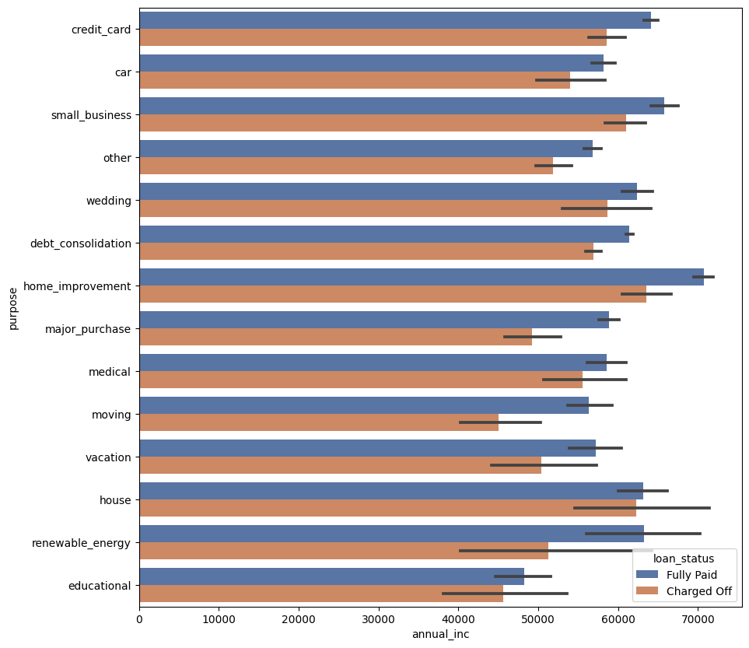
Analysis Result
Analysis :- By Annual income vs loan purpose
Findings/Observation:
Even if number of loans applied and defaulted are the highest in number for "debt_consolation", the annual income of those who applied isn't the highest.
Applicants with higher salary mostly applied loans for "home_improvment", "house", "renewable_energy" and "small_businesses"

Slide 17
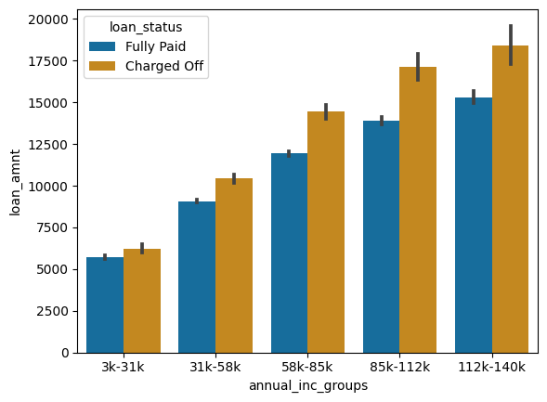
Analysis Result
Analysis :- By Annual income vs loan amount
Findings/Observation:
Across all the income groups, the loan_amount is higher for people who defaulted.

Slide 18
Analysis Result
Analysis :- By Annual income vs loan amount
Findings/Observation:
Across all the income groups, the loan_amount is higher for people who defaulted.

Slide 19
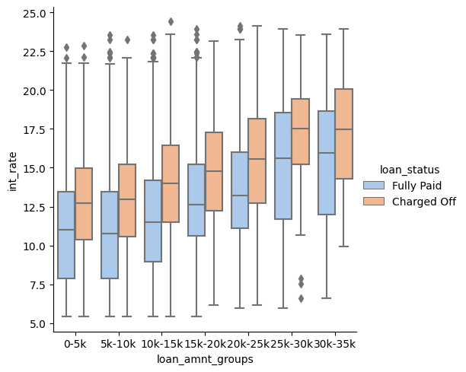
Analysis Result
Analysis :- By interest rate vs loan amount
Findings/Observation:
The interest rate for charged off loans is pretty high than that of fully paid loans in all the loan_amount groups.

Slide 20
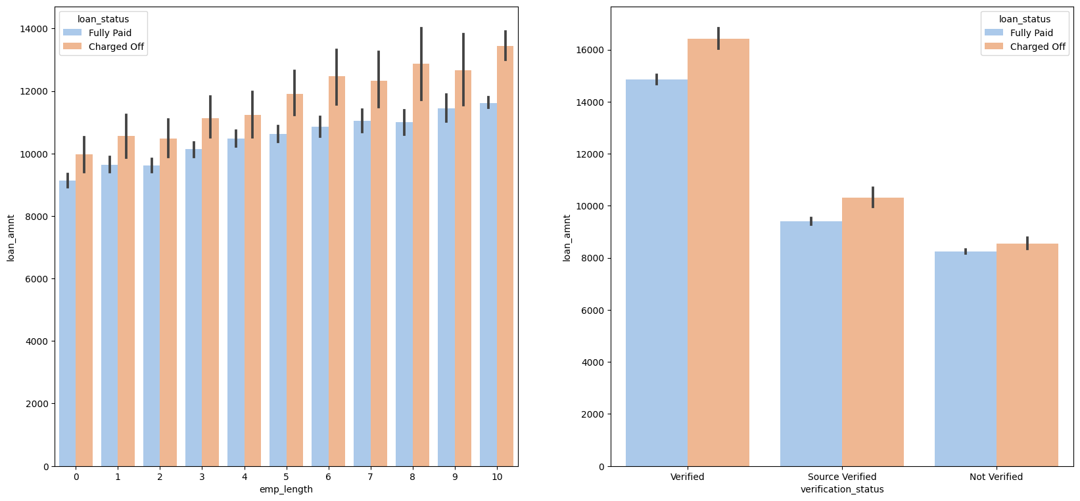
Analysis Result
Analysis :- By employee length vs loan amount and verified status vs loan amount
Findings/Observation:
Probability of defaulting loan is high when employment length is 10yrs and loan amount is 12k-14k and the loan is verified and loan amount is above 16k

Slide 21
The above analysis with respect to the charged off loans. There is a more probability of defaulting when :
Applicants taking loan for 'home improvement' and have income of 60k -70k
Applicants whose home ownership is 'MORTGAGE and have income of 60-70k
Applicants who receive interest at the rate of 21-24% and have an income of 70k-80k
Applicants who have taken a loan in the range 30k - 35k and are charged interest rate of 15-17.5 %
Applicants who have taken a loan for small business and the loan amount is greater than 14k
Applicants whose home ownership is 'MORTGAGE and have loan of 14-16k
When grade is F and loan amount is between 15k-20k
When employment length is 10yrs and loan amount is 12k-14k
When the loan is verified and loan amount is above 16k
For grade G and interest rate above 20%

Slide 22
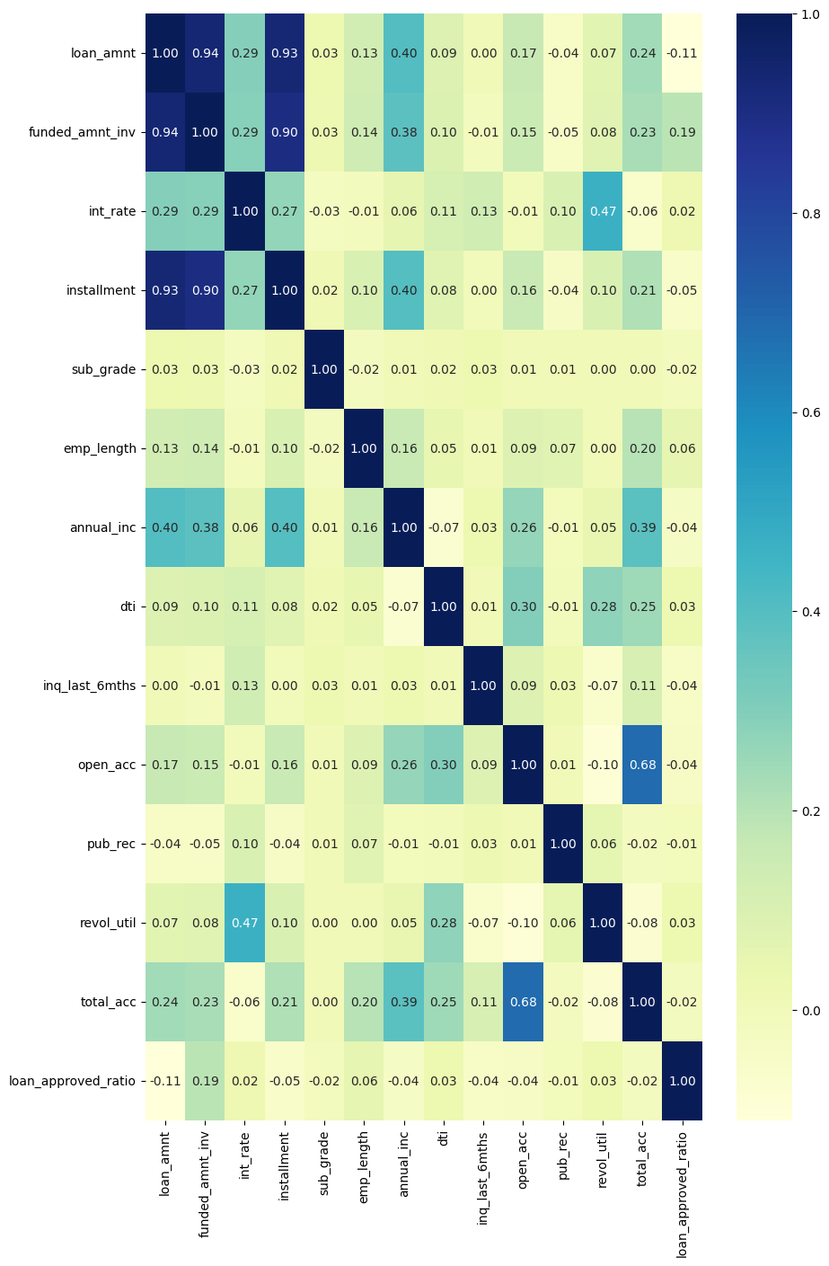
Multivariate Analysis
Findings/Observation:
There is a positive correlation between some entities and a negative correlation between some. Chances of default are strongly correlated with term and interest rate

